Slide 1
Answer Generation for Retrieval-based Question Answering System
Name: Kazi Al Refat Pranta
Student ID: 20101444
Group: 6
ST: Ehsanur
RA: Sabbir

Slide 2
INTRODUCTION
The paper familiarizes with a different approach for answer sentence selection which is a generative model. The approach is termed as GenQA that generate answers instead of selecting from a predefined candidate answer pool.
Contribution of this paper:
Different approach for AS2-based QA system
Adapt state-of-the-art models: T5 and BART
Improves AS2-based systems by accuracy point of 32
Identify that traditional generation metrics are not suitable for the evaluation of AS2 systems

Slide 3
dataset
WikiQA
Answer Sentence Natural Questions (ASNQ)
WQA
MS MARCO QA NLG ( MSNLG )

Slide 4
Methodology
1
3
Models and Parameterization
Generative QA Model
2
Generative Approach
4
Fine-tuning GenQA
UnifiedQA (UQAT5)
TANDA
RoBERTa
T5
BART

Slide 5
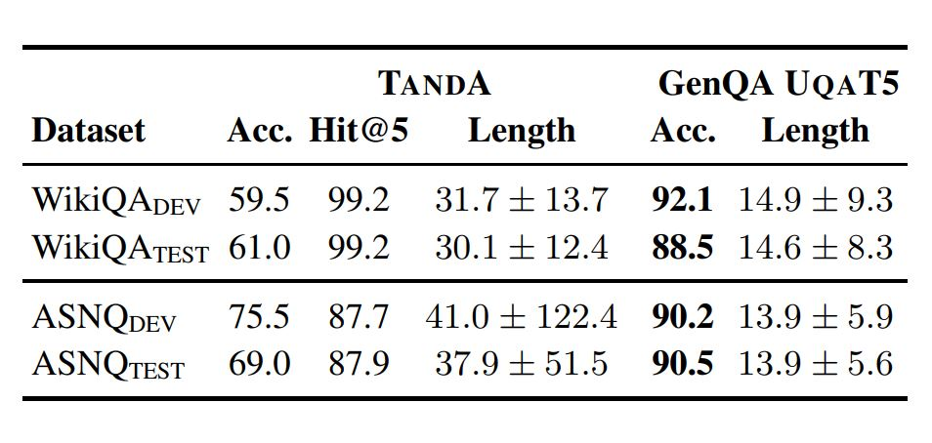
Evaluation
01
BLEU
02
ROUGE-L
03
Comparison between AS2 and GenQA

Slide 6
critical analysis
01
generative approach
03
More visual aids
02
new dataset, MSNLG
04
more models to evaluate

Slide 7
Thank you
Reference
Hsu, C. C., Lind, E., Soldaini, L., & Moschitti, A. (2021). Answer generation for retrieval-based question answering systems. arXiv preprint arXiv:2106.00955.

